Slide 1

MINIPROJECT 3
Akash Dalzell

Slide 2
Dataset
Target | Predictor
846 classified entries 4 classifications | 846 interger entries 17 different variables

Slide 3
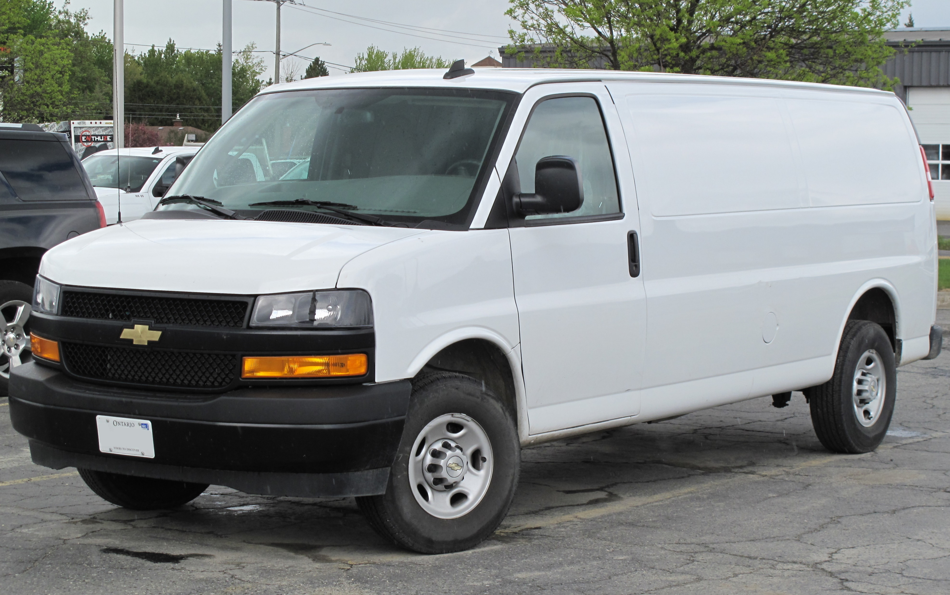
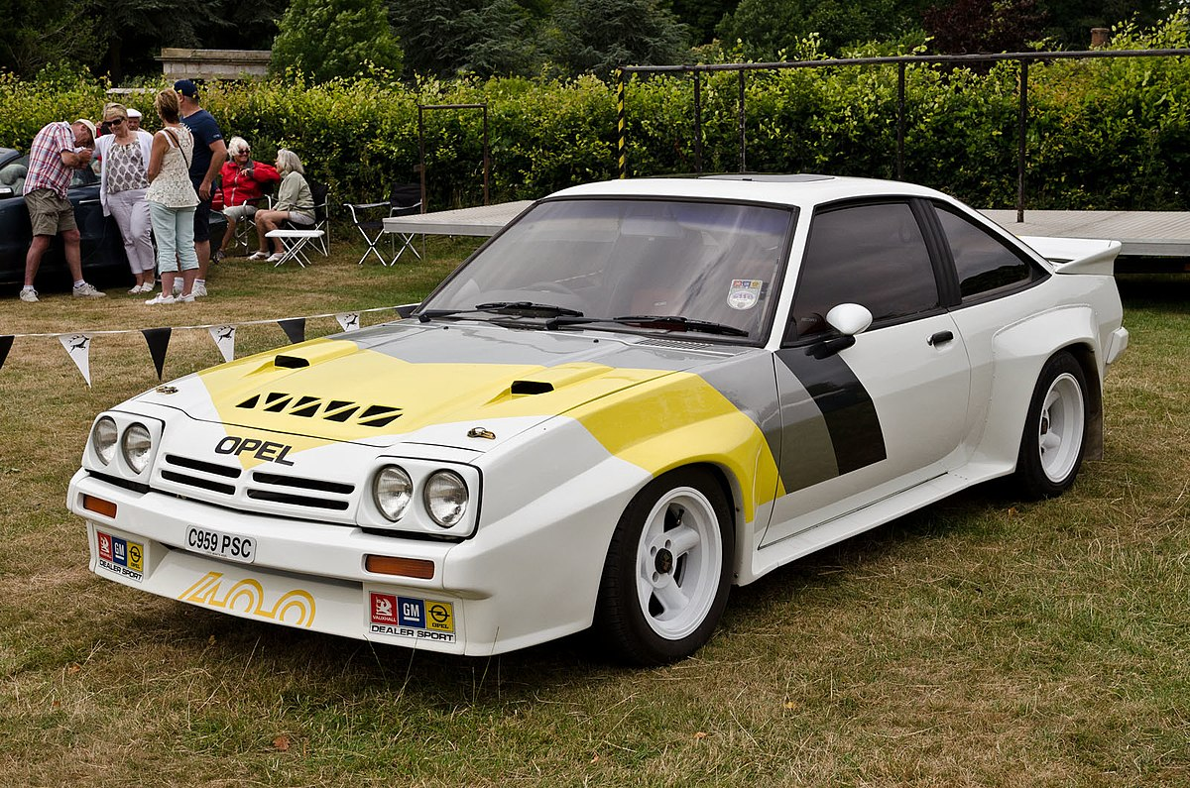
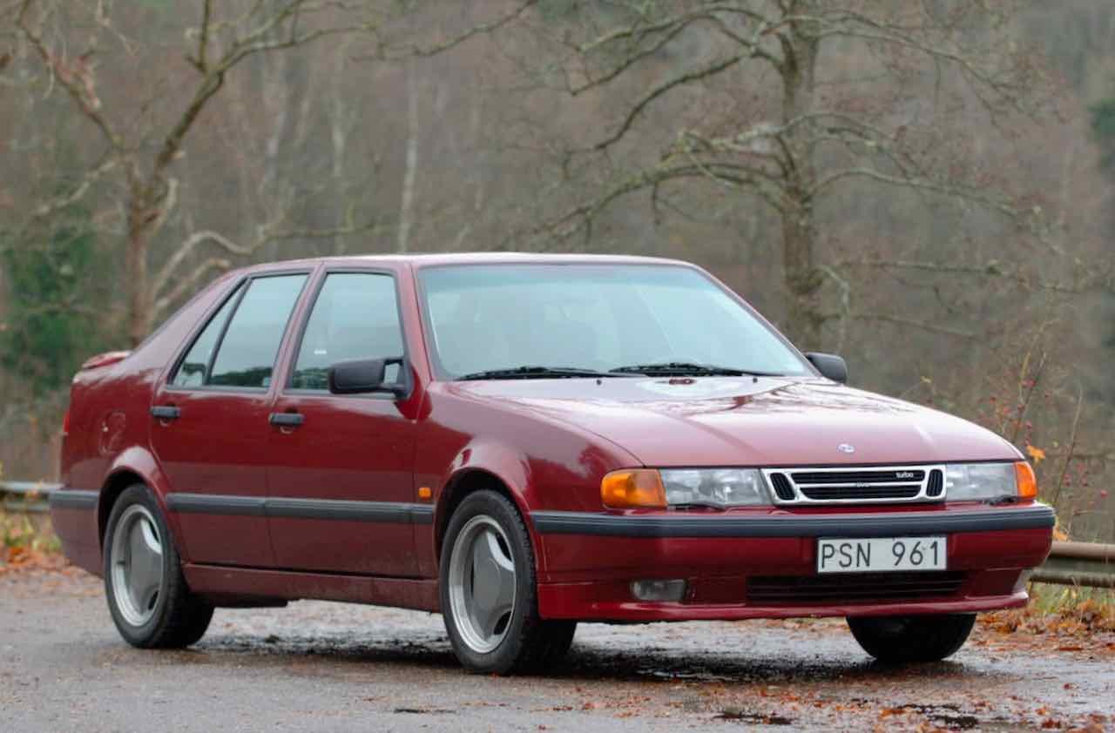
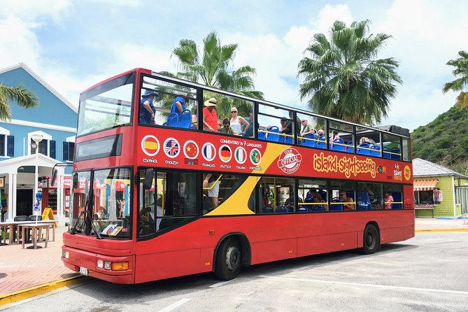
Target Variable

Slide 4
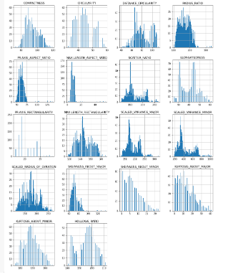
Predictor Variables
Most graphs have more than one mode, meaning that there are multiple peaks in the graph.
This is a great sign for us having to differentiate our given values into groups based on there position on the graph.
These peaks are the precursor to our clustering.

Slide 5
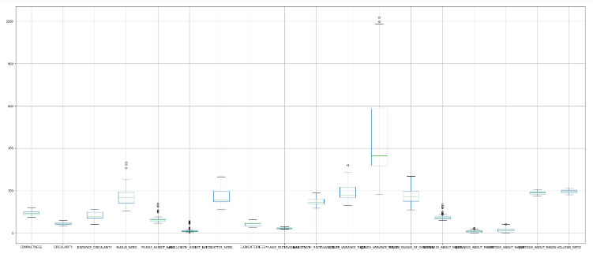
It is showing that there are some columns which contains outliers such as radius_ratio, pr.axis_aspect_ratio, max.length_aspect_ratio, scaled_variance, scaled_variance, skewness_about, skewness. It also shows the magnitudes of each variable.

Slide 6
Cleaning Data
No null values
0 values physically possible
Normalize
Local Outlier Factor

Slide 7
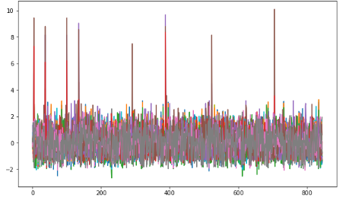
Before

Slide 8
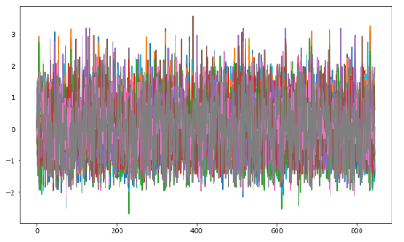
After

Slide 9
DBSCAN
Density-based clustering determines cluster assignments based on the density of data points in a region. Clusters are assigned where there are high densities of data points separated by low-density regions.
DBSCAN excels at identifying clusters of non- spherical shapes. It is also very resilient to outliers as they don't make much of a difference to the position of the cluster
DBSCANS draw backs are its susceptibility to the curse of dimensionality and if the clusters have varying sizes

Slide 10
Hyperparameters
minPts = 2 x number of variables
= 34
Epsilon depends on the distance function, to find this value we will use another model called K Nearest Neighbours

Slide 11
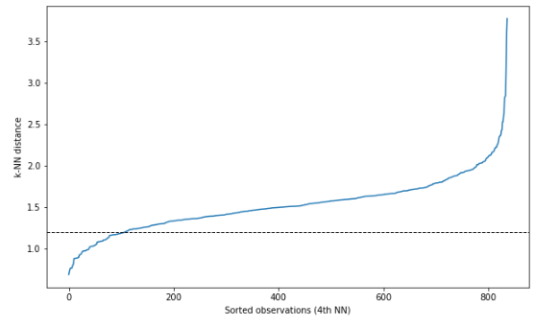
k-NN Distance Plot
Look for the knee, which is located at 1.2
Epsilon = 1.2

Slide 12
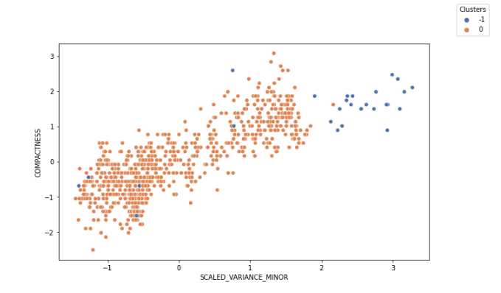
Results
One cluster
-1 is the noise

Slide 13
K Means
Group similar elements or data points together into pre-defined, non-overlapping clusters where each data point belongs to only one group.
The “K” in K-Means represent the number of centroid and in this case we will set K = 4 as there are 4 car types.

Slide 14
Advantages
Relatively simple to implement.
Scales to large datasets
Guarantees convergence
Chooses start position on its own
Generalizes to clusters of different shapes and sizes

Slide 15
Disadvantages
Manually have to choose k
Outliers may drag or create a new cluster
Curse of dimensionality
Dependent on initial conditions

Slide 16
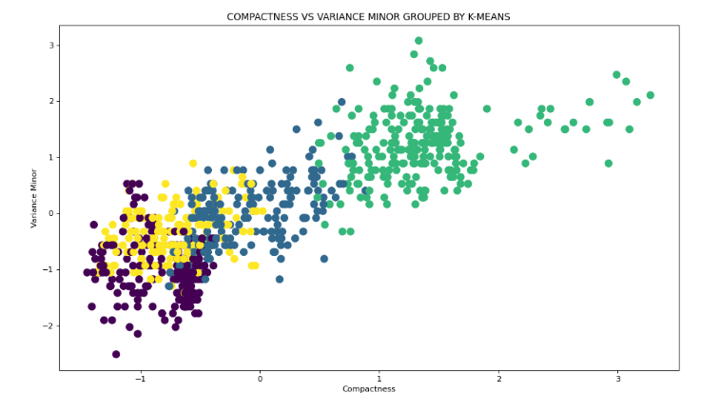

Slide 17
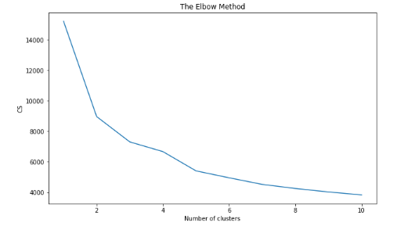

Slide 18
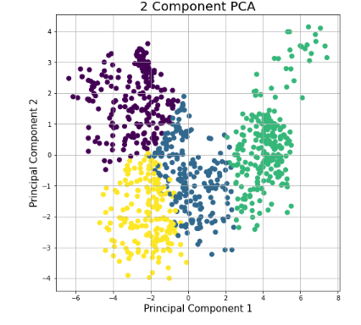
PCA

Slide 19
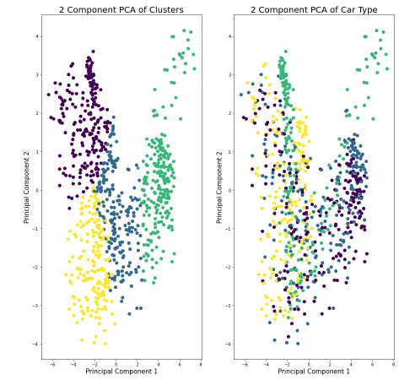

Slide 20
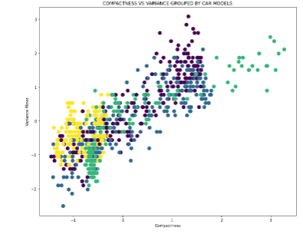

Slide 21
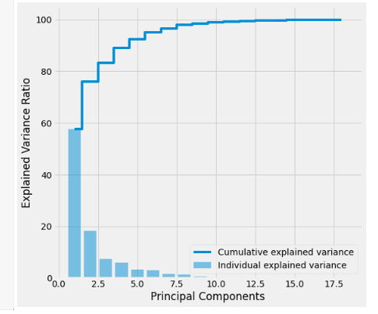
Dimension Reduction through PCA

Slide 22
Random Forests
n_estimators
max_features
max_depth
min_samples_split
min_samples_leaf
bootstrap

Slide 23
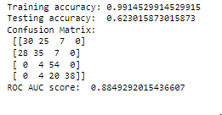
Base Model

Slide 24
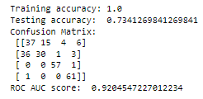
Optimized

Slide 25
SVC
Kernels
Gammas
C
Degree

Slide 26
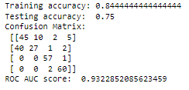
Base Model

Slide 27
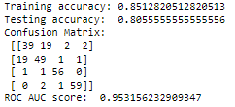
Optimized

Slide 28
Logistic Regression
Penalties
Solvers
C

Slide 29
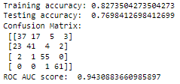
Base Model

Slide 30
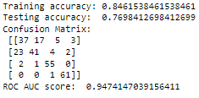
Optimized

Slide 31
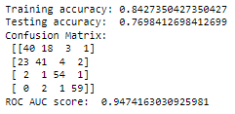
Ensembled Method
Bagging

